Slide 1
Ch2
K-Nearest Neighbors Alogorithm
Training set And Test set
Data Preprocessing
12191682 진태균

Slide 2
Contents
What is Machine Learning?
K-Nearest Neighbors Model
Training set And Test set
Data Preprocessing

Slide 3

What is Machine Learning?
Machine Learning (기계 학습)
- 패턴과 추론에 의존하여 명시적 명령 없이 문제를 해결하는 데
사용하는 알고리즘 및 통계 모델을 개발하는 분야
- 경험을 통해 자동으로 개선 가능
- 개발된 알고리즘은 더 많은 데이터에 노출됨에 따라
성능이 개선됨

Slide 4
What is Machine Learning?
Supervised Learning (지도학습)
Unsupervised Learning (비지도학습)
Reinforcement Learning (강화학습)

Slide 5
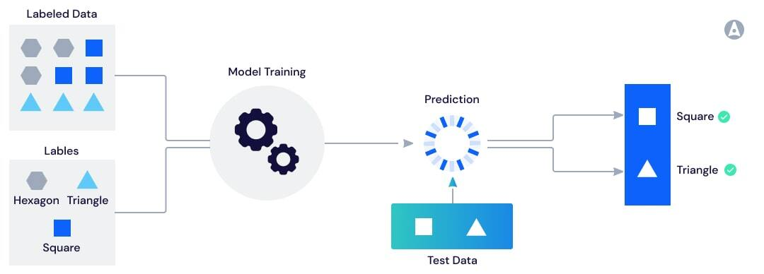
Supervised Learning

Slide 6
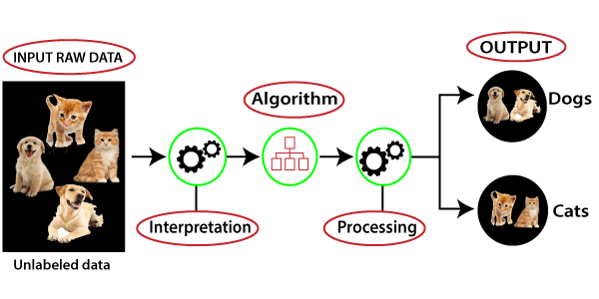
Unsupervised Learning

Slide 7
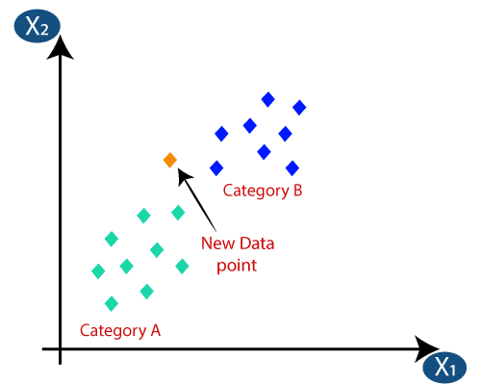
K-Nearest Neighbors Algorithm
K-최근접 이웃 알고리즘
- Classification 문제에서 사용 가능
- 새로운 규칙 보다는 기존의 훈련된
데이터와 입력값의 거리를 비교
-가장 가까운 K개의 데이터 중 많은
카테고리 쪽으로 결과값을 산출하는
알고리즘

Slide 8
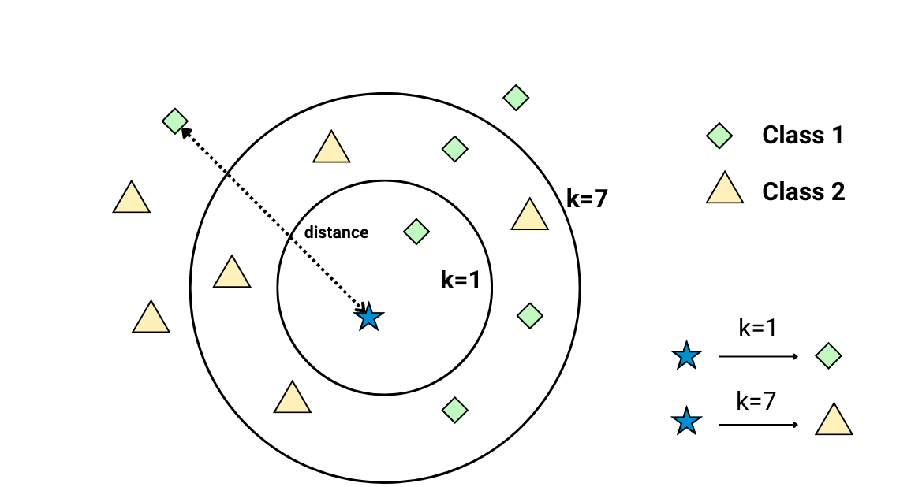
K-Nearest Neighbors Algorithm
Rely on memorization rather than a more traditional
approach to machine learning
2. Instance-based learning (memory-based learning)
- compare new data samples to training data samples
stored in memory
Lazy algorithm
- only performs computation when it receives new
observations. KNN defers calculation until it is given
a new test sample to classify.

Slide 9
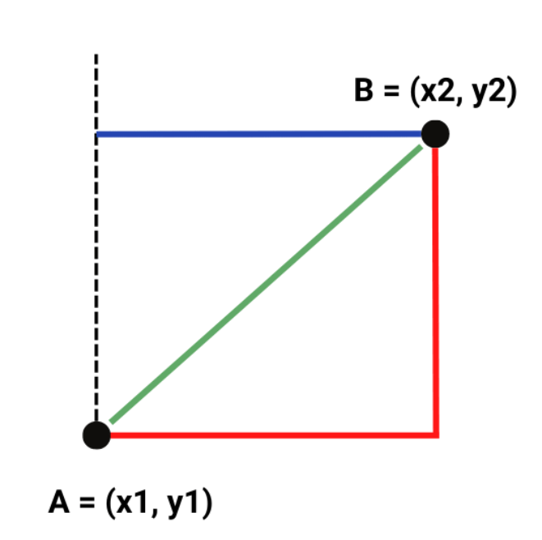
K-Nearest Neighbors Algorithm
Common Assumptions
Every sample in the training set has the same number of
attributes .
“Nearest Neighbors” are defined using specific distance
measure.

Slide 10
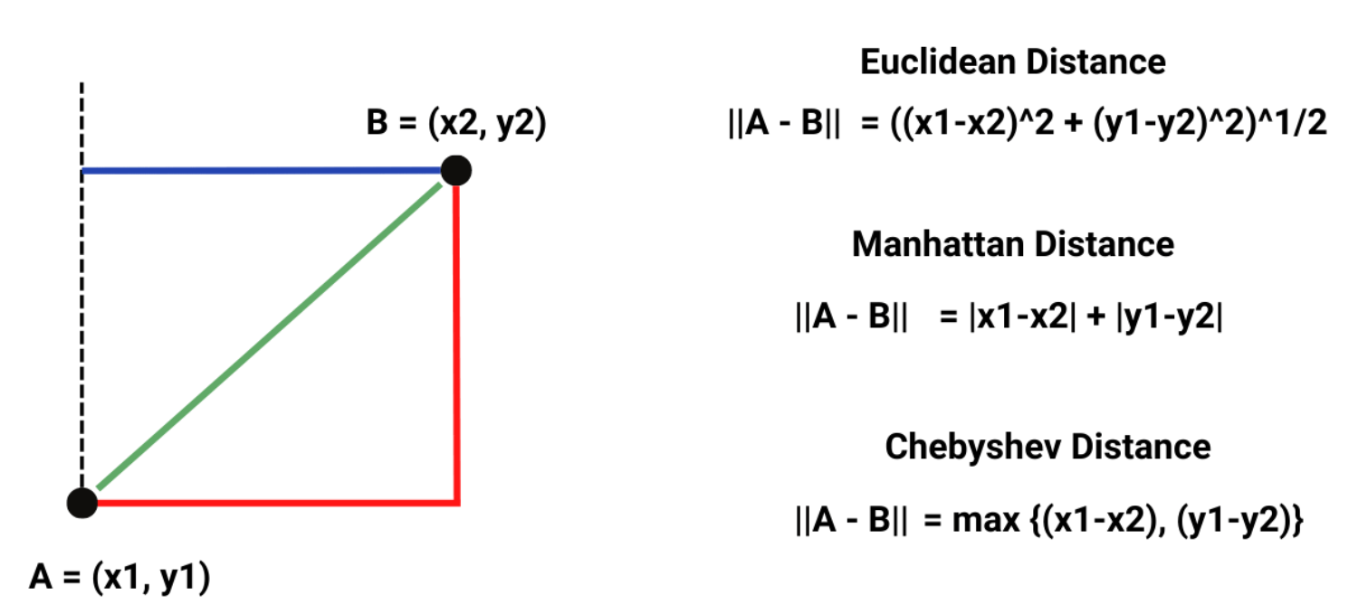
K-Nearest Neighbors Algorithm
Distance Measurement

Slide 11
K-Nearest Neighbors Algorithm
Working of KNN
Step 1 : Select K (from 1 to #samples)
Step 2 : Get training and test samples which we want to predict.
Step 3 : Find the K closest neighbors in the training set based on distance
Step 4 : Count how many neighbors are from the different classes
among the selected K neighbors.
Step 5 : Assign the test data sample to the class for which the neighbors
count was maximum.

Slide 12
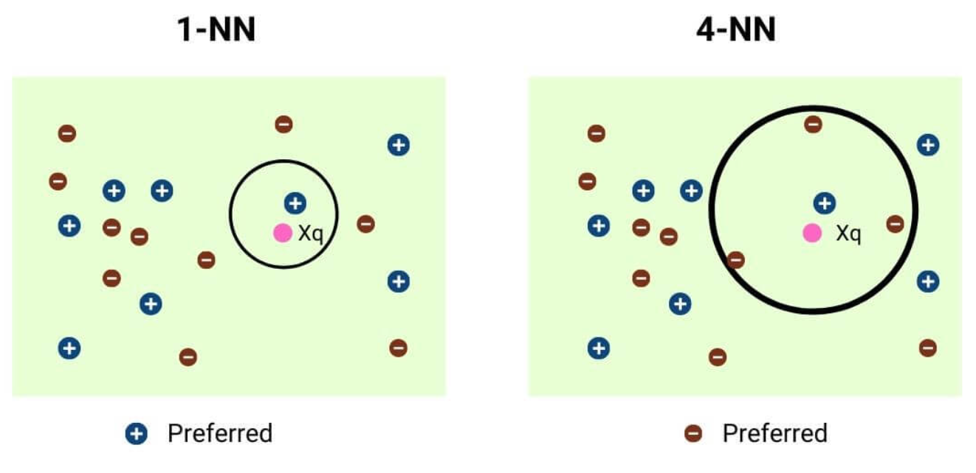
K-Nearest Neighbors Algorithm

Slide 13
K-Nearest Neighbors Algorithm
K = 1
Variance (분산)
Bias (편향)
K = #samples

Slide 14
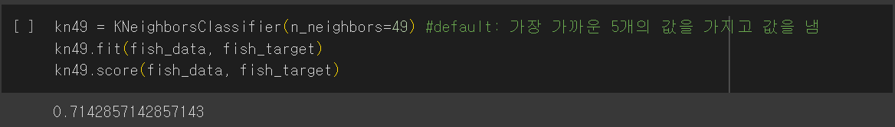
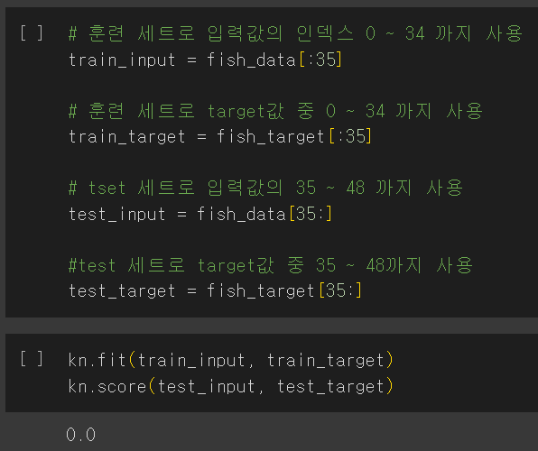
K-Nearest Neighbors Algorithm
Sampling bias (샘플링 편향)
- Training set과 Test set의 Sample이
골고루 섞여 있지 않고 한쪽으로
치우쳐진 상태

Slide 15
K-Nearest Neighbors Algorithm
Advantages
Disadvantages
Zero training time
Explainability
Ease of adding and removing data
Insensitivity to class imbalance
Needs a lot of storage
Predictions are slow
- time complexity : O(dN)
d : the number of features
N : the number of samples
Irrelevant features can fool the nearest neighbors.

Slide 16
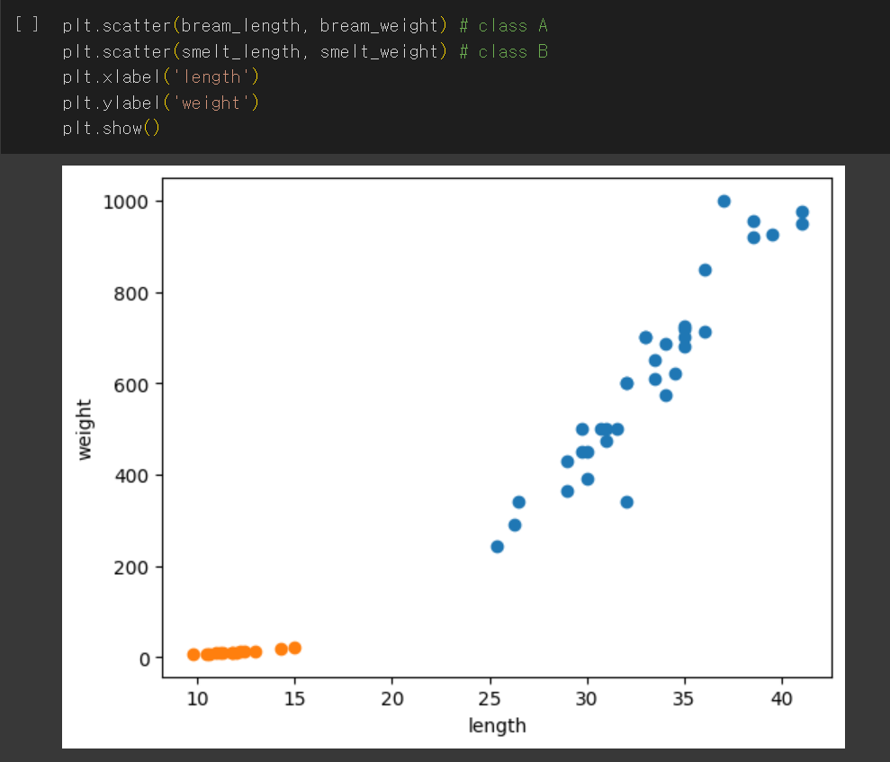
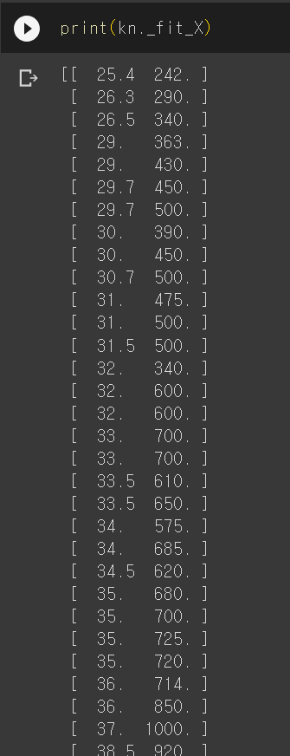
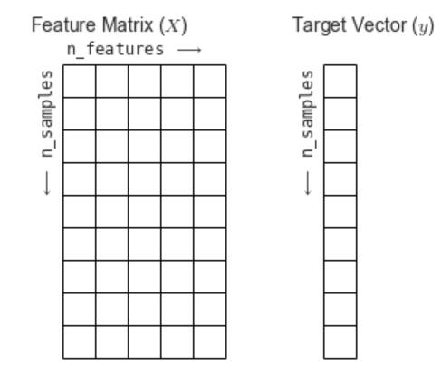
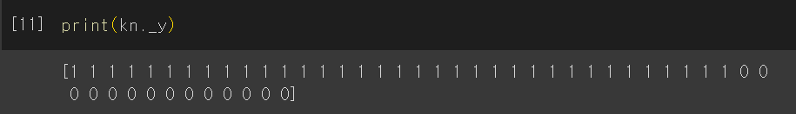
K-Nearest Neighbors Algorithm

Slide 17
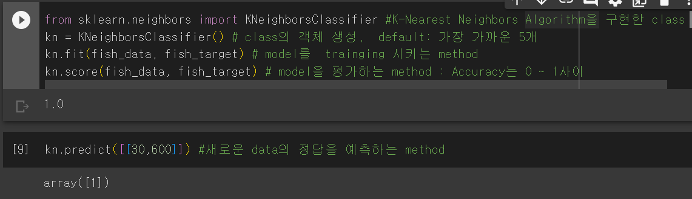
K-Nearest Neighbors Algorithm

Slide 18
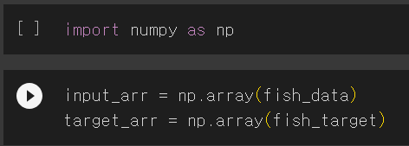

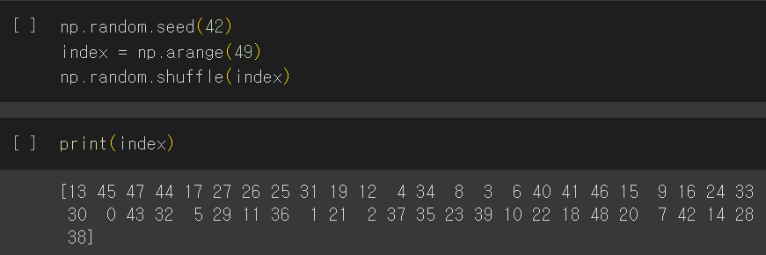
Training set And Test Set
: 대규모 다차원 배열을 쉽게 처리할 수 있도록 지원하는 Python library

Slide 19
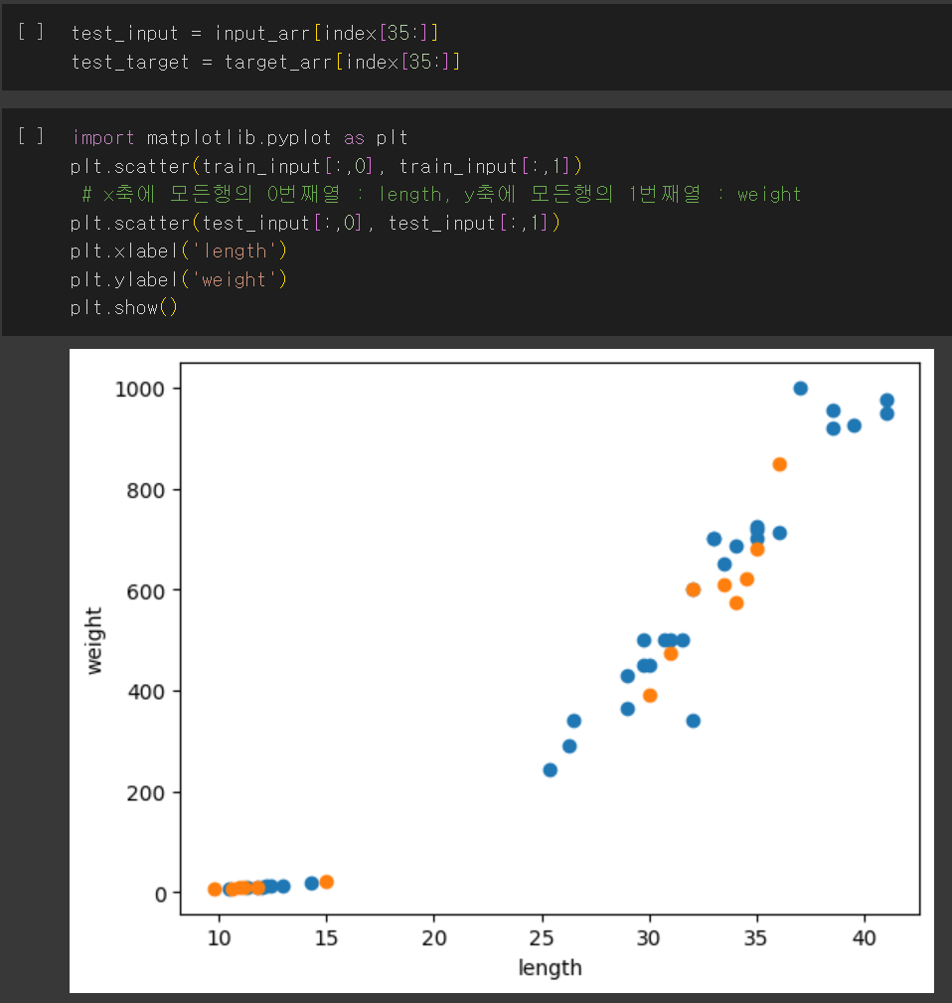
Training set And Test Set

Slide 20

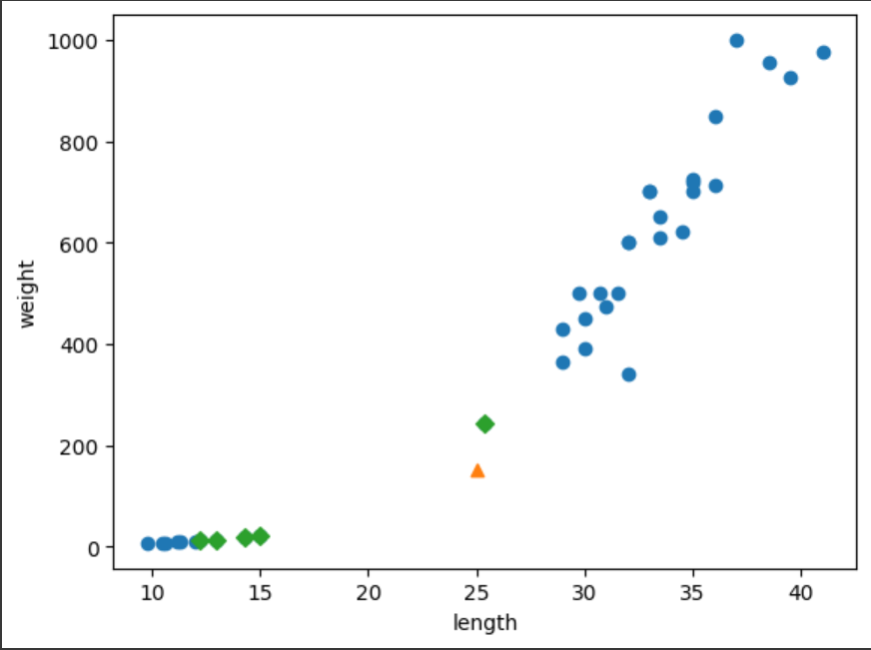
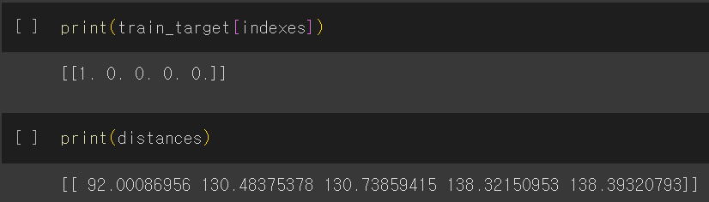
Data Preprocessing

Slide 21
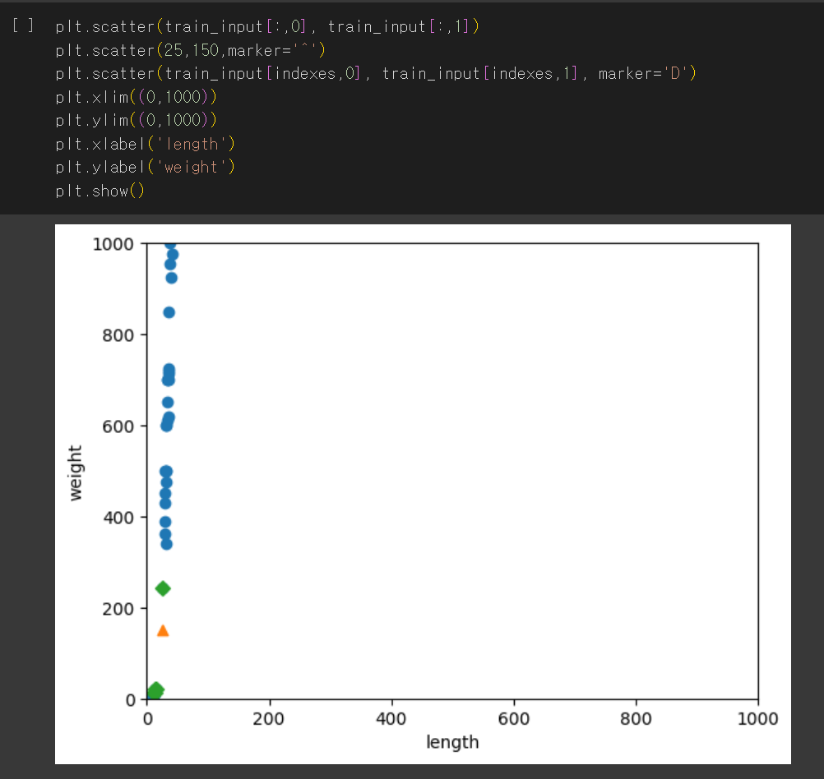
Due to the significant difference in scale
between the two features,
the length feature is being disregarded.
When there is a difference in the units
used to represent the data,
distance-based algorithms can lead to
critical errors.

Slide 22
Data Preprocessing (데이터 전처리)
Data Preprocessing : Feature들 간의 Scale을 맞춰 주는 작업
- min-max normalization (최소-최대 정규화) : 변수의 범위를 0에서 1
까지로 나타냄
Z = ( X - min(X) ) / ( max( X ) - min( X ))

Slide 23
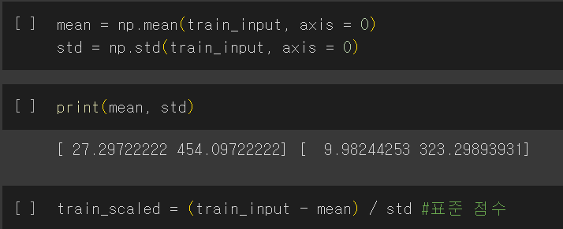
Data Preprocessing
Data Preprocessing : Feature들 간의 Scale을 맞춰 주는 작업
- standard score (표준점수) : 각 특성값이 평균에서 표준편차의 몇 배만큼
떨어져 있는지 나타내는 값
standard score = (feature – mean) / std
mean : training set 의 각각의 특성의 평균값
std : training set 의 각각의 특성의 표준편차

Slide 24
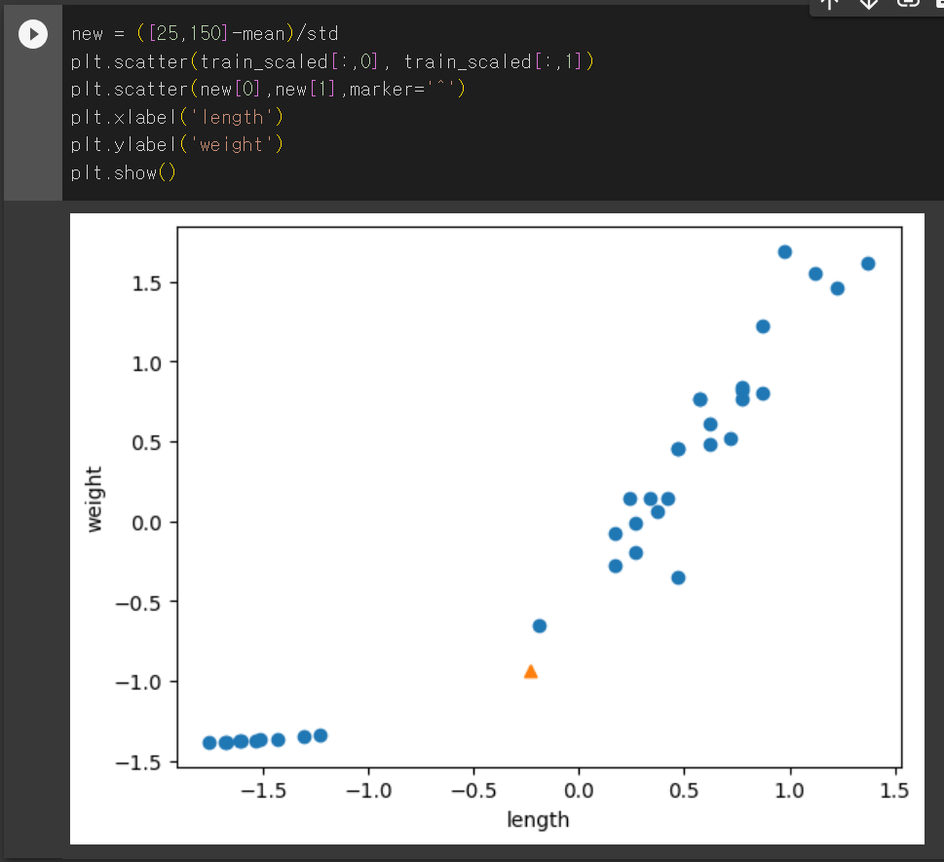
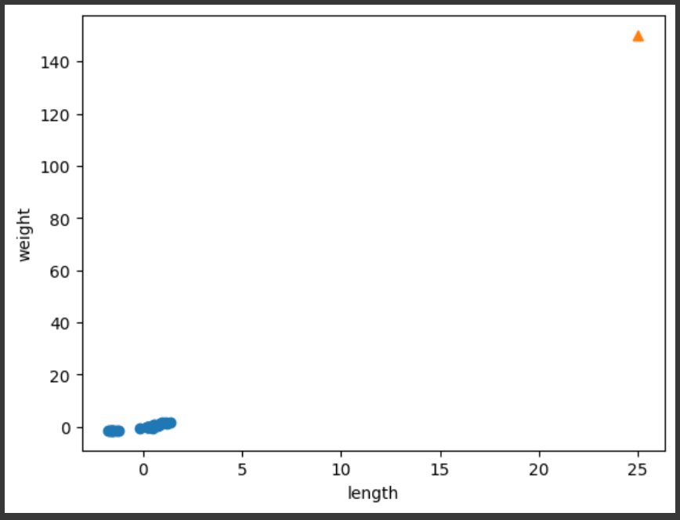
Data Preprocessing

Slide 25
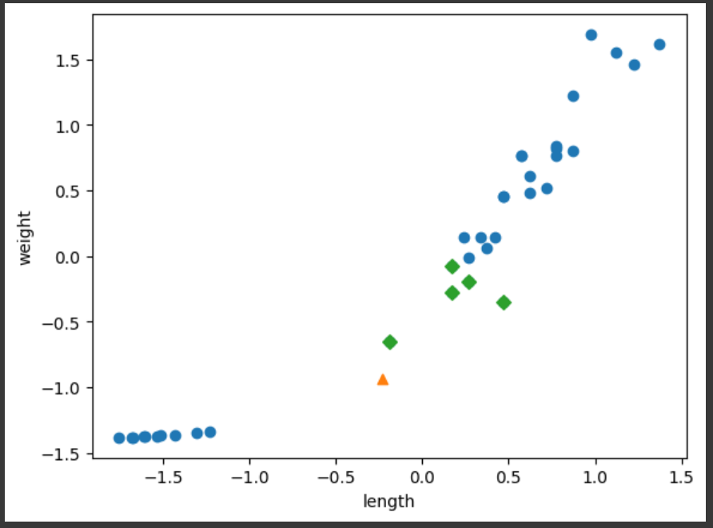
Data Preprocessing

Slide 26
감사합니다

